Slide 1
CSC3067
Video Analytics and Machine Learning
Group Assignment
Pedestrian Detection
Jesús Martínez del Rincón
j.martinez-del-rincon@qub.ac.uk

Slide 2
Learning outcomes
Explain when and how machine learning and computer vision is useful in industry, public institutions and research.
Know and apply a range of basic computer vision and machine learning techniques.
Demonstrate the ability to understand and describe the underlying mathematical framework behind these operations
Design and develop machine learning pipelines applied to computer vision applications

Slide 3
Learning outcomes
Formulate and evaluate hypothesis
Evaluate the performance of proposed machine learning solutions through rigorous experimentation
Analyse quantitative results and use them to refine initial solutions
Communicate finding effectively and in a convincing manner based on data, and compare proposed systems against existing solutions

Slide 4
Assessment - Coursework
Practical assignment (40%)
More details on Week 6
In groups of 3
Learning outcomes 4 to 8
Must attain at least 40 % (24 marks) of total marks available in the coursework
10% Initial baseline system
Week 9
30% Final report and code
Week 11

Slide 5
Critical Analysis
Justify every single decision based on objective data and reasoning
For example:
“We applied SVM.”
“We applied SVM because it is a good classifier.” Mehh
“We applied SVM because its requires few training images, which fits our problem where few images were available. ” Good
“We applied SVM because its requires few training images, which fits our problem where few images were available. This was supported empirically by its comparison with NN, where a 10% was achieved, as shown in table 1” Excellent!!!

Slide 6
Assistance
We are here to help
If you don’t understand then please ASK
Email: j.martinez-del-rincon@qub.ac.uk, B.Ahmaderaghi@qub.ac.uk - No response to queries for which the information is already provided
Office Hours
Jesus: Wednesday 14:00 - 17:00 CSB/03.013
Baharak: Thursday 10:00 – 13:00 21 Stranmillis Road
MS Teams: Feel free to call, share your screen, etc
Drop us an email before!

Slide 7






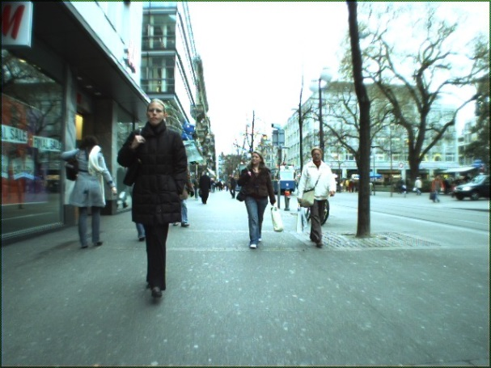
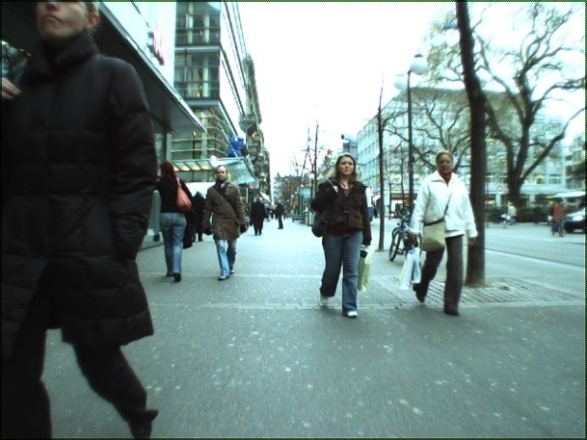
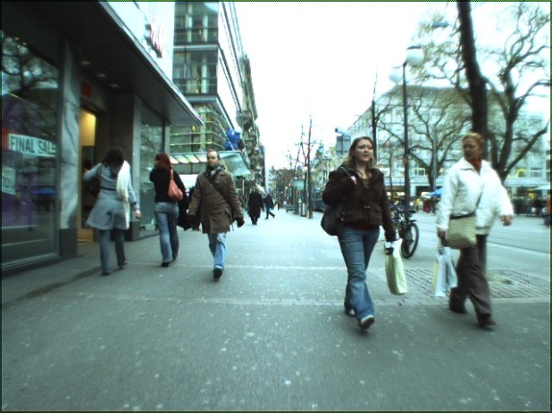
Topic
Pedestrian Detection
Machine Learning
Detection
x
x
x
√
√
√

Slide 8
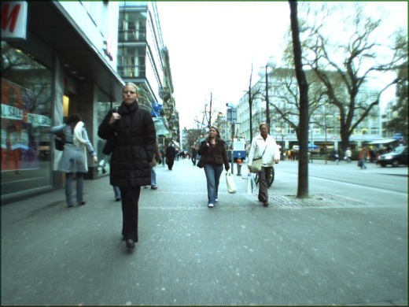

Pedestrian Detector
Training set
Test set
Automatic
System

Slide 9
Training the automatic system (32 marks)
2 Main components
A feature descriptor.
Describe an image region with a high-dimensional descriptor.
Options:
Histogram of gradients (HOG) features. (Prac 6)
Full image (Prac 5 & 6)
Dimensionality reduction techniques (Prac 7)
A learning method. (Prac 4)
Learn to classify an image region (described using one of the features above) as a pedestrian or not.
Options:
SVM
Nearest Neighbour,
K-NN
Folders images\neg and images\pos contains crops to
be used for training
Justify your choice and the parameter values. Analysis

Slide 10
Testing the classification system (21 marks)
In order to justify previous choices, we need to divide dataset (both positive and negative examples) in 2 subsets: training and testing
Training samples and their labels for learning
choose the best techniques, strategies and parameters for each block using the testing
Options:
Half/half
Cross validation
Evaluate the performance of your final choice
Options:
Recognition rate
TP, FP, TN, FN (Prac 6)
Precision, recall, specificity, sensitivity, etc… (Prac 6)

Slide 11
Detection implementation (37 marks)
Apply your classification/verification system to implement a pedestrian detector
2 important components
A sliding window detector. (Based on Prac 4)
Crop the image at every location and use the classifier to tell if that image region contains a person. By scanning every location on the full image, it will detect all instances of pedestrians in that image.
In order to detect pedestrians at multiple sizes, our sliding window detector should run at multiple scales (will require resizing image)
Non-maxima suppression. (Prac 5)
Overlapping detections are a common problem. NMS removes overlapping detection to improve performance. It keeps best detections in each region by selecting the strongest responses.
Using test.dataset file, we can read the real location of people in the image sequence
For each image, the (x, y, width and height) parameters of the bounding box of each person in that frame, so it can be compared against our output
Calculate the performance of our detector quanatitatively
Generate output video
Reflect and explain the results that you have obtained
Why and when it fails?

Slide 12
Available code
No implementation, only usage
Prac 4 provides a SVM toolbox and matlab library alternative
Prac 5 provides a HOG feature extractor
Prac 6 provide LDA dimensionality reduction method
You should already developed in the practicals (but you can improve them)
Preprocessing: Prac 1-2
NMS at Prac 5
K-NN classifier at Prac 4
Tracking filters for comparison at Prac 7
Concepts of sliding windows at Prac 4 and 5
Video recorder at Prac 3
Evaluation metrics at Prac 6
PCA at Prac6
Main bits to implement:
Multi-scale sliding window

Slide 13
Basic System
As many combination of methods (specially feature extraction and classifiers)
The final performance does not determine the mark
Correct experimental setup
Correctly evaluated (quantitative data)
Tables, graphs,…
Good parameter setting
Good analysis and explanation of results and decisions taken

Slide 14
Excellent system +Extra Credit (10 Marks)
Use of Boosting/bagging, Random trees or NN/DNN for classification
Cross validation (leave one out) as experimental setup
ROC curves to evaluate
Explore your own feature extractor
Part-based detectors
Tracking by detection

Slide 15
Initial Demo (10%)
Date: 15th -17th November
With Baharak or me or a demonstrator
10 min per group
Using Ms Teams
Formative and summative
Opportunity to get feedback on your progress, alternative things to try, what to do until final submission, etc..
You will get a marking template and written feedback
10% of the final mark
Goal and expectations:
Show real progress at that stage. Results of some initial combinations of features+classifiers, initial attempt to the detector, parameter tuning,….
Prac4 and 5 completed give you a good baseline
The more, the better
You will need to submit the presented slide deck, tables, results etc..
The more professional the better

Slide 16
Deliverables
Written report (7th December)
Code (7th December)
Peer Assessment (8th December)
Through Canvas

Slide 17
Report
In order to obtain all the points in each section, the report must be clear and explain and justify each decision
Good structure
Logical order: training, testing, etc…
The more pictures and tables with results, the better
Module guide
Skills:
1. Communication 5. Working with others

Slide 18
Code
I must be able to run it
And understand your code
Comments
Good structure
Gitlab - Compulsory
I will provide you a git per group in the next few days
Code
Videos of your results
I should obtain the same results that in the report
Not all the intermediate results, but the final ones

Slide 19
Peer Assessment
Professional behaviour
Respect to the others
Me as a moderator. Raise issues as soon as possible.
WARNING!! All the members are supposed to contribute in all the aspects
Criteria: 4 marks (out of 10) in 4 categories
Design, Implementation, Testing, Report
Give also a general comment summary (1 paragraph)

Slide 20
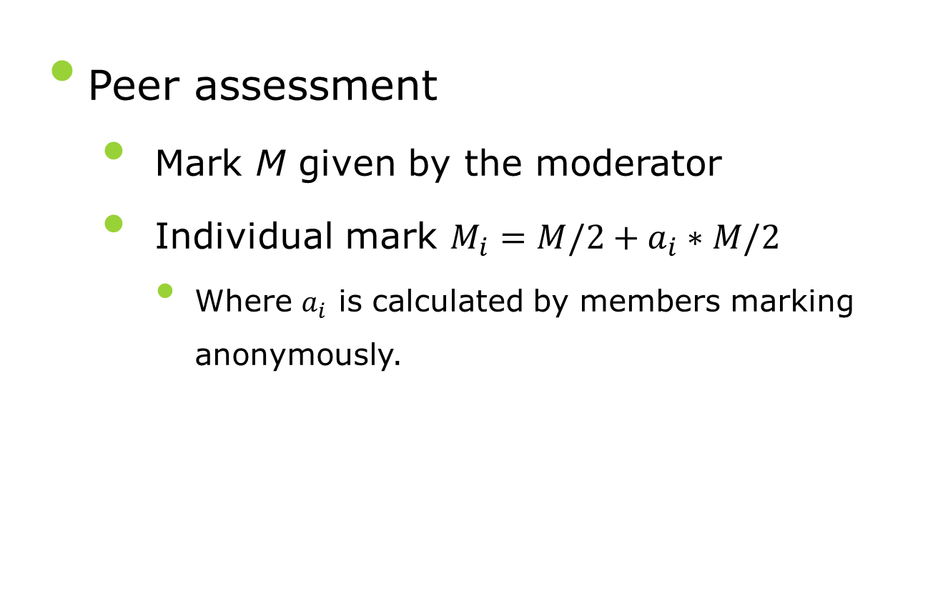
Peer Assessment
Peer assessment
Mark M given by the moderator
Individual mark $M_{i}=M/2+a_{i}∗M/2$
Where $a_{i}$ is calculated by members marking anonymously.

Slide 21


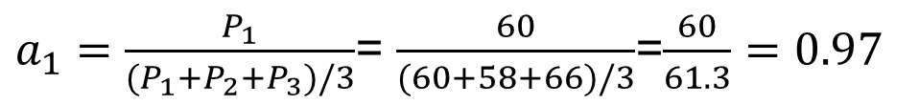
Peer Assessment
Hanna’s Formula
Example: 3 member, M=15
$$a_{i}=\frac{P_{i}}{\sum_{j=1}^{N}{P_{j}}}$$
Member 2 about Member 1
Design =8
Implementation=7
Testing=7
Report=9
Total =31
Member 3 about Member 1
Design =7
Implementation=7
Testing=7
Report=8
Total=29
P1=31+29=60
$a_{1}=\frac{P_{1}}{(P_{1}+P_{2}+P_{3})/3}$= $\frac{60}{(60+58+66)/3}$=$\frac{60}{61.3}=0.97$
$$M_{1}=\frac{15}{2}+0.97∗\frac{15}{2}=14.7$$

Slide 22
Issues and demo
Raise group problems as soon as possible
Moderating the mark
Analysing group member contribution
Use Gitlab to measure individual contributions
I keep the right to fully remark individuals and groups
If needed a group interview will be called
All members of the group should be present
We will agree a date

